Slide 1
Accessing the Curriculum for Diverse Learners
Applied Behaviour Analysis in the Classroom

Slide 2
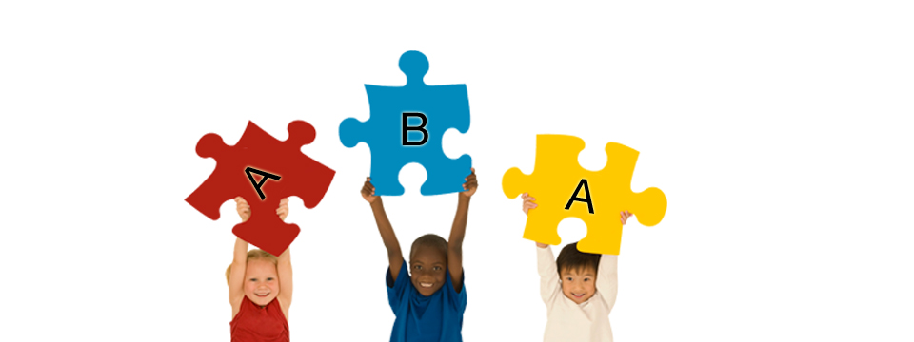
Applied Behaviour Analysis (ABA)
Field of psychology
Focuses on applying learning theories to improving behaviour
Systematic approach
Evidence based treatment
Used for over 30 years and modified to be used in more natural settings (school and community)

Slide 3
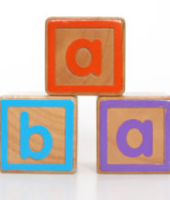
Applied Behaviour Analysis (ABA)
Typically delivered in highly structured, controlled and therapeutic environments
Implemented 1:1 or with small groups
Focuses on communication skills, social skills, academics, improving attention

Slide 4
ABA
The applied component means:
    The procedures are meant to be put to meaningful use in real life settings like school and the community
  The behaviour component means:
    The target behaviour is operationally defined and that it can be observed and measured
The analytic component means:
    Data is collected and analyzed to make informed decisions regarding teaching

Slide 5
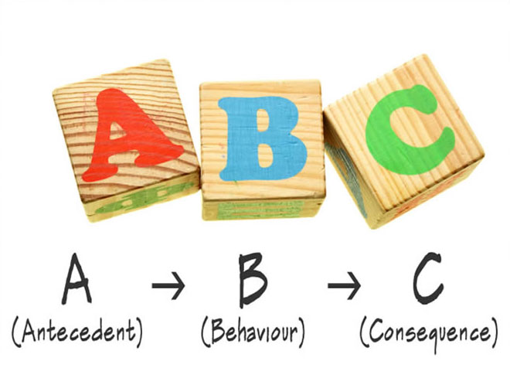
ABA Approaches
Many different techniques
All focus on the
  A-B-C sequence
  what happens before
  the behaviour / response
  consequences

Slide 6
ABA Therapies
Discrete Trial Learning
Incidental Teaching (or natural environment training)
Verbal Behaviour
Pivotal Response Training
Natural Language Paradigm
All are:
Structured
Collect data for target skills or behaviours
Provide positive strategies (positive reinforcement) for changing responses and behaviour

Slide 7

Contemporary ABA Strategies
Direct observation
Antecedent strategies
Modeling
Use of Peers
Shaping
Prompting
Positive Behaviour Supports
Functional Communication Interventions
Utilizing a person’s preferences for activity choices and reinforcers
Generalization

Slide 8
ABA is not the same thing as DTT
Discrete Trial Training / Teaching (DTT) is only one tool of ABA

Slide 9
Discrete Trial Teaching (DTT)
Fosters learning through repetition in a concentrated period of time
Isolates skills and teaches them in their smallest necessary components to foster learning of more complex concepts
Appropriate for skills that can be broken down into small, discrete steps
Skills need a clear beginning, middle and end
Provides prompting and prompt fading
Utilizes positive reinforcement

Slide 10
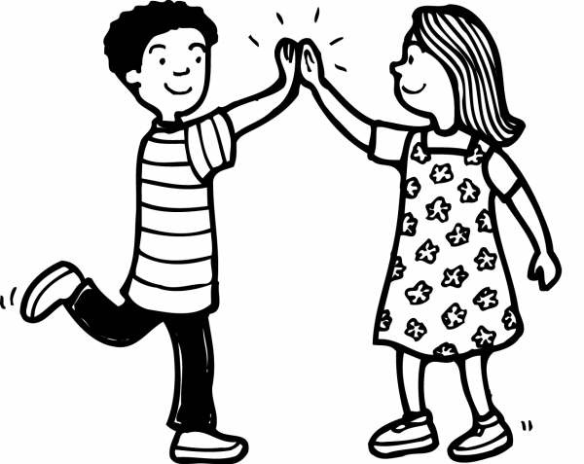
What is a Discrete Skill?
A discrete skill is a skill that cannot be broken down any further. It usually involves one step:
  Activating a voice output device
  Saying hello
  Giving a high five
  Reading a sight word

Slide 11
Discrete Trial Training
A structured way of teaching
Each trial has a clear beginning and end
Trials are distinct and succinct
A trial is one set of instructions

Slide 12
DTT Components
TRIAL:
Obtain attention (very important)
Deliver instruction / provide cue (SD = stimulus)
Learner Responds
Consequence (positive reinforcement or correction)
Pause before next trial (only a few seconds)
  Take data
  Set up for next trial

Slide 13
The Components of a Trial
Cue
Task Direction
Tells learner the skills or behaviours they should be using
Learner Response
Target Skill you want the student to acquire
Correct or incorrect
Feedback
Positive Feedback: highly positive feedback and descriptive
Feedback for incorrect response: ignore or apply a correction procedure

Slide 14
The Components of a Trial
Cue
Task Direction
“Sit down”
Learner Response
Target Skill you want the student to acquire
Jon sits down
Feedback
Positive Feedback: highly positive feedback and descriptive
Adult hands Jon a favorite toy

Slide 15
The Components of a Trial
Cue
Task Direction
“Point to the ball”
Learner Response
Target Skill you want the student to acquire
Sam points to the ball.
Feedback
Positive Feedback: highly positive feedback and descriptive
“Yes, that’s the ball”. Sam gets small truck to play with.

Slide 16

Discrete Trial Teaching in Action

Slide 17
Discrete Skill or Not?
Taking a book from the library
Giving an answer to a math question
Handing a flash card to a peer
Going to the bathroom
Calendar routine at Circle Time
Saying the sound of a letter
Completing a worksheet
Ordering lunch from the school cafeteria

